Slide 1
A simulation Benchmark System
AMSG pysig Group 3 final project review
Yongxin Tan, Yanghui Xiao, Yifei Huang, Lijuan Wang, Yijiang Zhang
2015-05-26

Slide 2
Project specification
A web based SPICE simulator regression benchmark system
Supported simulated
HSPICE VS FineSim
FineSim VS HSPICE
Convenient simulator binary selection
Default daily build binary
User input binary
Web based input and output
Decouple regression run and regression result show
Run regression any time, show result any time.

Slide 3
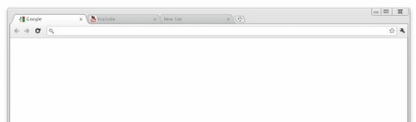
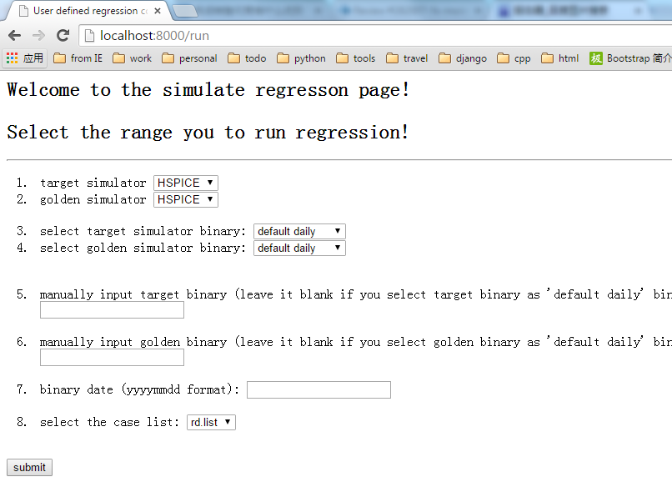





Run regression
http://localhost:8080/run
Collect user input information

Slide 4
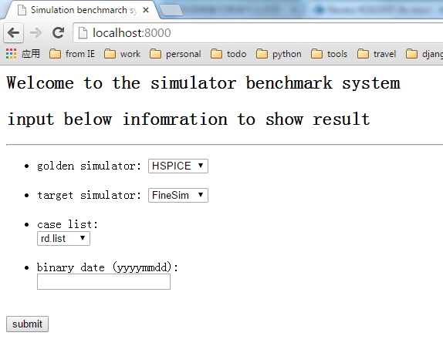
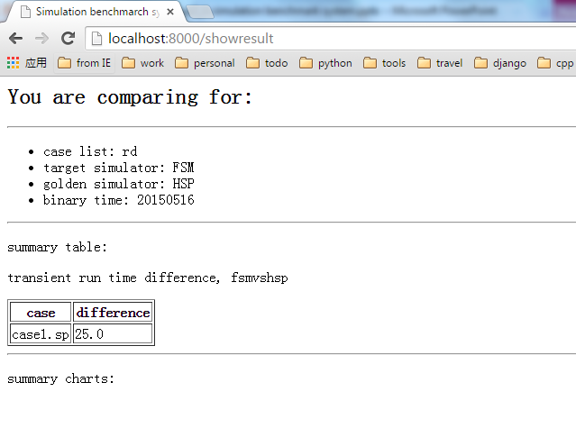
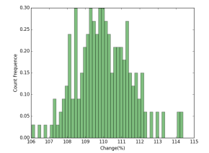
Show results
http://localhost:8080/
Collect user input information

Slide 5
Show case:

Slide 6
Technique High Light
Using github for project synchronizing
https://github.com/easyfly007/finalproj
Web based UI
More friendly.
Using Django for web frame work development
Convenient and mature Module-View-Template framework.
Using Matplotlib module for output visualization
Using SQLite3 database
Decouple run regression and run result.

Slide 7
Next step:
Deploy to the production server
More simulator for benchmark (FineSim, CustomSim, HPP, etc.)
More result (accuracy, performance, etc) for compare

